Slide 1

Restaurant Location Recommendation
Yogesh T. Subramanian

Slide 2
In this project we will try to find an optimal location for a restaurant. Specifically, this report will be targeted to stakeholders interested in opening an Indian Cuisine restaurant in Delhi, India. Finding a suitable location for restaurants in major cities like Delhi proves to be a daunting task. Various factors such as over-saturation or no demand, for the type of restaurant that the customer wants to open, effect the success or failure of the restaurant. Hence, customers can bolster their decisions using the descriptive and predictive capabilities of data science. Our goal here is to find the neighbourhoods with low density of Indian restaurants
Goal

Slide 3
Recommender System
Machine learning
Exploratory analysis
Inferential analysis
Method

Slide 4
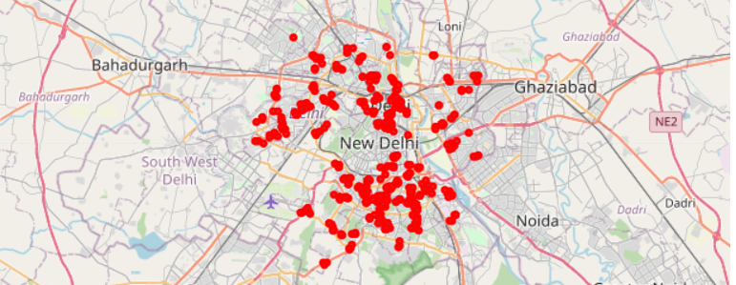
Delhi’s Neighbourhoods

Slide 5
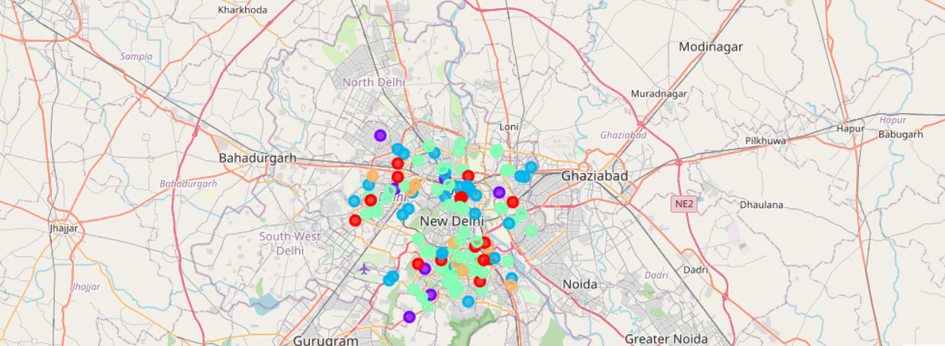
Clustering Delhi’s Neighbourhoods

Slide 6
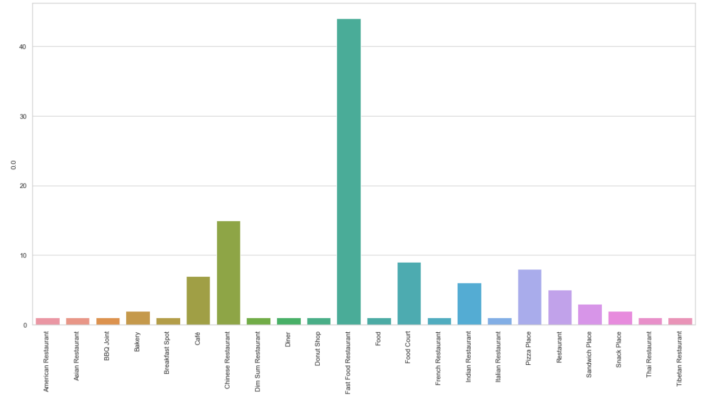
Restaurant Types

Slide 7
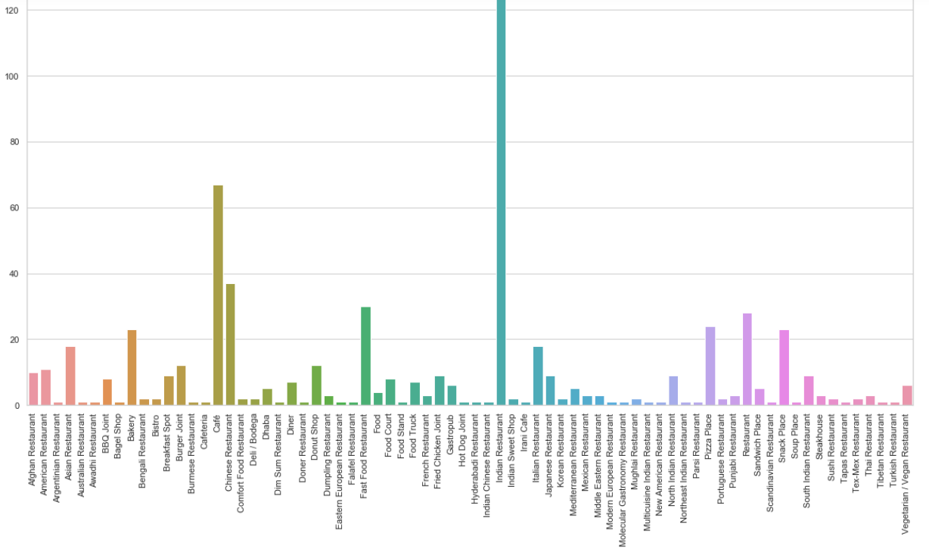
Restaurant Types

Slide 8
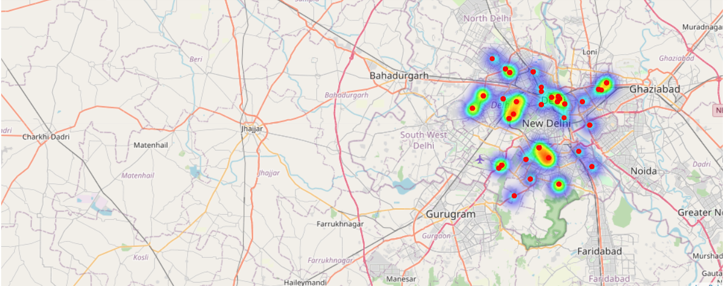
Heat map of density of restaurant

Slide 9
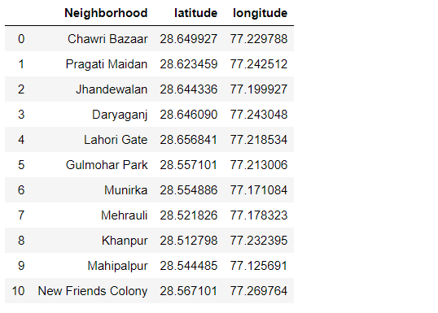
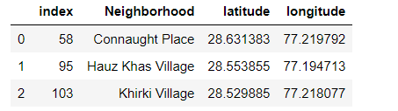
Results and conclusions

Slide 10
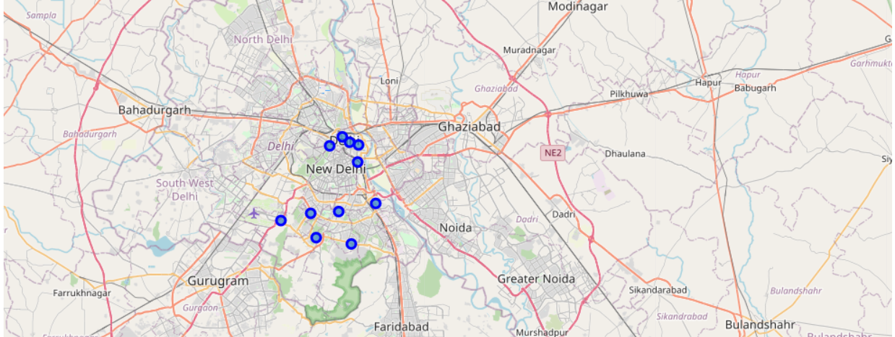
Top locations for restaurant

